Slide 1
Protocol Layers
CPSC 3600

Slide 2
R16: Consider sending a packet from a source host to a destination host over a fixed route. List the delay components in the end-to-end delay. Which of these delays are constant and which are variable?
R18: How long does it take a packet of length 1,000 bytes to propagate over a link of distance 2,500 km, propagation speed 2.5 *10^8 m/s, and a transmission rate of 2 Mbps? More generally, how long does it take a packet of length L to propagate over a link of distance d, propagation speed s, and transmission rate R bps? Does this delay depend on packet length? Does this delay depending on transmission rate?
R19: Suppose Host A wants to send a large file to Host B. The path from Host A to Host B has three links, of rates R1 = 500 kbps, R2 = 2 Mbps, and R3 = 1 Mbps
a) Assuming no other traffic in the network, what is the throughput for the file transfer?
b) Suppose the file is 4 million bytes. Dividing the file size by the throughput, roughly how long will it take to transfer the file to Host B?
c) Repeat a) and b), but now with R2 reduced to 100 kbps

Slide 3
P6: This elementary problem begins to explore propagation delay and transmission delay, two central concepts in data networking. Consider two hosts, A and B, connected by a single link of rate R bps. Suppose that the two hosts are separated by m meters, and suppose the propagation speed along the link is s meters/sec. Host A is to send a packet of size L bits to Host B.
a) Express the propagation delay, d_prop in terms of m and s.
b) Determine the transmission time of the packet d_trans in terms of L and R.
c) Ignoring processing and queuing delays, obtain an expression for the end-to-end delay
d) Suppose Host A begins to transmit the packet at time t = 0. At time t = d_trans, where is the last bit of the packet?
e) Suppose d_prop is greater than d_trans. At time t = d_trans, where is the first bit of the packet?
f) Suppose d_prop is less than d_trans. At time t = d_trans, where is the first bit of the packet?
g) Suppose s = 2.5*10^8, L=120 bits, and R = 56 kbps. Find the distance m so that d_prop = d_trans.

Slide 4
P7: In this problem, we consider sending real-time voice from Host A to Host B over a packet-switched network (VoIP), Host A converts analog voice to a digital 63 kbps bit stream on the fly. Host A then groups the bits into 56-byte packets. There is one link between Hosts A and B; its transmission rate is 2 Mbps and its propagation delay is 10 msec. As soon as Host A gathers a packet, it sends it to Host B. As soon as Host B receives an entire packet, it converts the packet's bits to an analog signal. How much time elapses from the time a bit is created (from the original analog signal at Host A) until the bit is decoded (as part of the analog signal at Host B)
P12: A packet switch receives a packet and determines the outbound link to which the packet should be forwarded. When the packet arrives, one other packet is halfway done being transmitted on this outbound link and four other packets are waiting to be transmitted. Packets are transmitted in order of arrival. Suppose all packets are 1,500 bytes and the link rate is 2 Mbps. What is the queuing delay for the packet? More generally, what is the queuing delay when all packets have length L, tranmission rate R, x bits of the currently-being transmitted packet have been transmitted, and n packet are already in the queue.

Slide 5
P20: Consider the throughput example corresponding to Figure 1.20(b). Now suppose that there are M client-server pairs rather than 10. Denote Rs, Rc, and R for the rates of the server links, client links, and network link. Assume all other links have abundant capacity and that there is no other traffic in the network besides the traffic generated by the M client-server pairs. Derive a general expression for throughput in terms of Rs, Rc, R, and M.

Slide 6
Protocol Layers
Networks are complex, with many pieces
Hosts
Routers
Different types of links
Applications
Protocols
Hardware/software
To help manage this complexity, network protocols are implemented in several layers
Each layer only has to talk to the layer above it and below it

Slide 7
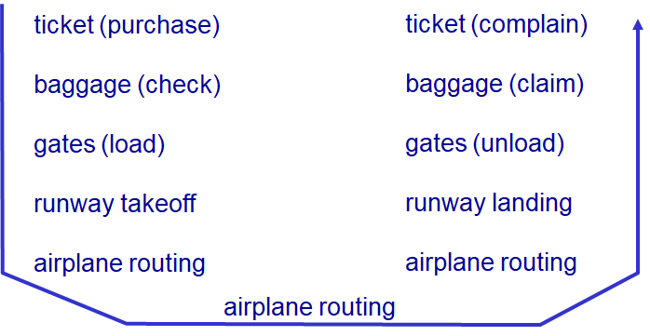
Analogy: Airline Travel

Slide 8
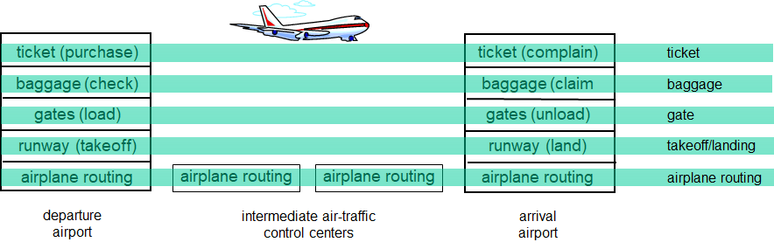
Analogy: Airline Travel
Each layer implements a service
Via its own internal-layer actions
Relying on services provided by layer below it
Using data from the layer above it

Slide 9
Why layering?
Explicit structure allows identification, relationship of complex system pieces
Layered reference model for discussion
Modularization eases maintenance, updating of system
Changing implementation of a layer is transparent to the system
E.g. Changing gate procedure doesn’t affect anything else

Slide 10
Internet Protocol Stack
Five layers in the Internet’s protocol stack
Application: supports network applications
e.g. FTP, SMTP, HTTP
Transport: process-process data transfer
e.g. TCP, UDP
Network: routing of packets from source to destination
e.g. IP, routing protocols
Link: data transfer between neighboring network elements
e.g. Ethernet, 802.1, PPP
Physical: bits “on the wire”

Slide 11
Application Layer
Application Layer
“Talks to” destination transport layer
Ports
Transport Layer
Transport Layer
“Talks to” other network layers
IP Addresses
Network Layer
Network Layer
“Talks to” the next link layer
MAC Addresses
Link Layer
Link Layer
Actually “talks”
Physical Layer
Physical Layer

Slide 12
Application Layer
Creates the data to be sent
Application Layer
Socket API
Transport Layer
Provides services, basic routing (ports)
Transport Layer
Network Layer
Keeps routing tables up to date Forwards incoming packets to outgoing link
Network Layer
Link Layer
Handles logistics of communication across the adjacent link
Link Layer
Injects bits onto the physical medium
Physical Layer
Physical Layer
Bits moving across physical medium

Slide 13
ISO/OSI Reference Model
Adds two additional layers
Presentation: allow applications to interpret meaning of data, e.g. encryption, compression, machine-specific conventions
Session: synchronization, checkpointing, recovery of data exchange
Internet stack doesn’t have these layers, if these services are needed they must be implemented in the application

Slide 14
Encapsulation
Each layer has to add additional information to a packet, related to that layer’s function
This information is appended to the packet (encapsulated)
This information is then extracted and used the next time that packet is processed by another layer of the same type
See more detail later about what is added by each layer

Slide 15
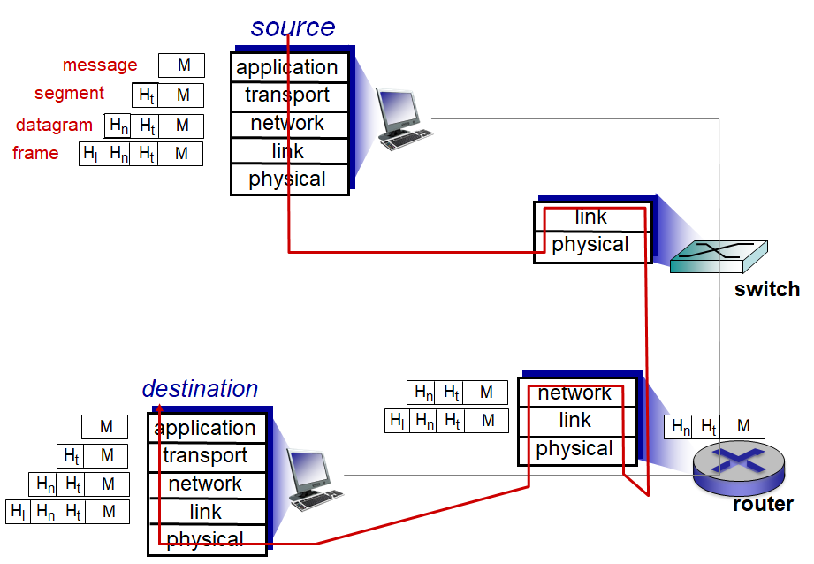

Slide 16
Application Layer
Standardizes protocols used when communicating between processes on separate hosts
HyperText Transfer protocol (HTTP)
File Transfer protocol (FTP)
Simple Mail Transfer protocol (SMTP)
Domain Name System (DNS)
Anyone can create their own standards that reside in the “application” layer
Responsible for creating the payload of a packet

Slide 17
Find other application/network protocols besides HTTP, FTP, SMTP, DNS

Slide 18
Transport Layer
Moves packets from host application to destination application
Transport layer packets referred to as segments
Two transport protocols for the Internet
UDP: connectionless service, no reliability, flow/congestion control
TCP: connection-oriented service, guarantees packets will be delivered correctly, handles flow/congestion control
Transport layer is where many essential services are implemented

Slide 19
Transport Services
Four major classes of services that can be offered
Reliable data transfer
Throughput
Timing
Security
Important to remember: we’re focusing on the Internet, one specific type of network that can be implemented
The Internet’s transport layer does not implement all of these services

Slide 20
Reliable Data Transfer Services
Packets can get lost when crossing a link
Queue overflow leads to dropped packets
Bits get corrupted due to interference/noise
This is OK for some applications (e.g. streaming video), but devastating for others (e.g. financial applications, email)
Reliable data transfer guarantees packets will be delivered successfully (or you’ll know if they weren’t)

Slide 21
Throughput Services
Some applications need a guaranteed amount of throughput to be useful (e.g. VoIP application)
Beneficial if this throughput could be guaranteed, (similar to a circuit switched network)

Slide 22
Timing Services
Other applications would benefit from guarantees about how long it will take to deliver a packet (e.g. multiplayer video games)
Timing services would attempt to ensure delivery within the specified window

Slide 23
Security Services
Many different possible security services
Encrypt the data stream, ensure no one can read it except recipient
Ensure data integrity, no one has tampered with the data
Authenticate the end-point, make sure the recipient is who you think they are

Slide 24
TCP Service
TCP includes a reliable transfer service, can include security features with SSL
Also provides basic error checking, congestion control mechanism, flow control

Slide 25
UDP Service
UDP only provides basic error checking, no other guarantees
Faster (ignoring congestion), more lightweight than TCP

Slide 26
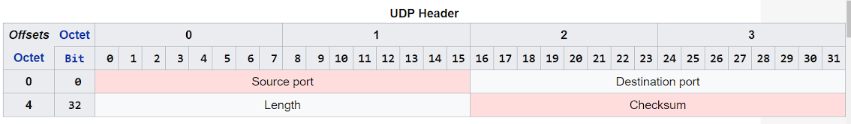
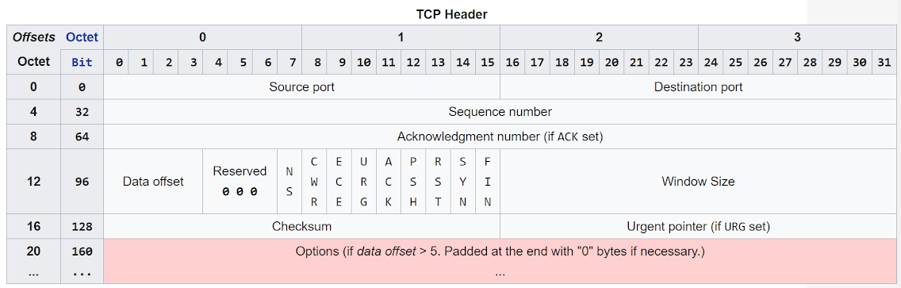

Slide 27
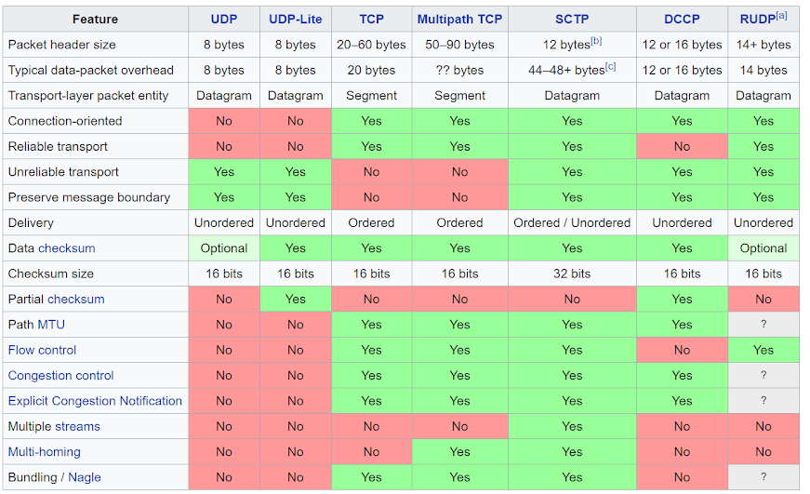

Slide 28
What is a network port, and why is it important?

Slide 29
Network Layer
Routes segments from their source to their destination
Network layer packets referred to as datagrams
Two major functions
Routing
Forwarding

Slide 30
Routing
Routing keeps the routers knowledge of downstream destinations up to date
Maintains the forwarding table by communicating with other routers
Looks for network outages so as to reroute packets
Periodic process, takes seconds to complete

Slide 31
Forwarding
Forwarding determines which output link an incoming packet should be transmitted on
Accomplished using the forwarding table created during by the routing function

Slide 32
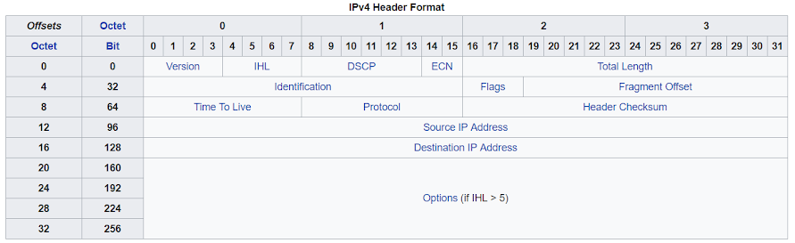

Slide 33
Link Layer
Moves datagrams from one network element to the next
Link layer packets referred to as frames
Only deals with the link between two routers/switches
Examples of protocols include Ethernet, WIFI, DOCSIS
Possible for a packet to cross several links using different protocols before it reaches its destination
Lives in the network interface card

Slide 34
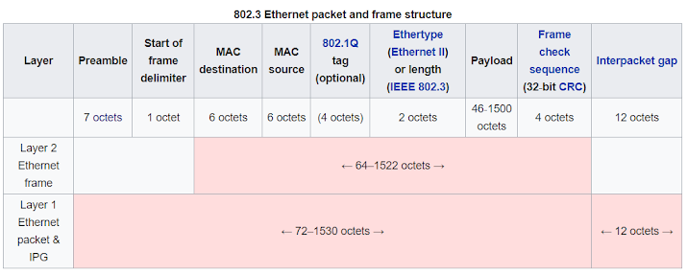

Slide 35
Physical Layer
Moves individual bits of a frame from one node to the next
Hardware-level features required to transmit bits across the used physical media
Protocols here depend on the protocol used in the link AND on the physical medium the link is made of
E.g. different protocols for Ethernet when using twisted-pair cable vs. coaxial vs. fiber

Slide 36
Application Layer
Application Layer
“Talks to” destination transport layer
Ports
Transport Layer
Transport Layer
“Talks to” other network layers
IP Addresses
Network Layer
Network Layer
“Talks to” the next link layer
MAC Addresses
Link Layer
Link Layer
Actually “talks”
Physical Layer
Physical Layer

Slide 37
Application Layer
Creates the data to be sent
Application Layer
Socket API
Transport Layer
Provides services, basic routing (ports)
Transport Layer
Network Layer
Keeps routing tables up to date Forwards incoming packets to outgoing link
Network Layer
Link Layer
Handles logistics of communication across the adjacent link
Link Layer
Injects bits onto the physical medium
Physical Layer
Physical Layer
Bits moving across physical medium

Slide 38
Explain the five layers used in the Internet model to your neighbor
What are the layers?
What services do they provide?
What header information do they add to a packet (encapsulation)

Slide 39
Name one of the five layers in the Internet’s layered model.

Slide 40
Which layer is responsible for routing packets to their destination?
Application Layer
Link Layer
Network Layer
Physical Layer
Transport Layer

Slide 41
Which layer can provide the following services: reliable data transfer, throughput guarantees, timing guarantees?
Application Layer
Link Layer
Network Layer
Physical Layer
Transport Layer

Slide 42
Which layer appends source/destination MAC addresses to the packet?
Application Layer
Link Layer
Network Layer
Physical Layer
Transport Layer

Slide 43
Which layer appends source/destination ports to the packet?
Application Layer
Link Layer
Network Layer
Physical Layer
Transport Layer

Slide 44
Before Next Class
Read Section 2.1, 2.5
Complete the first Wireshark Lab

